Slide 1
Mana Punch
Team Inverted X
Wolfgang Westdorp, Scott Dagen, Matthew Randolph, Adam Dionne, Dante Xystus, Zachary Neiheiser

Slide 2
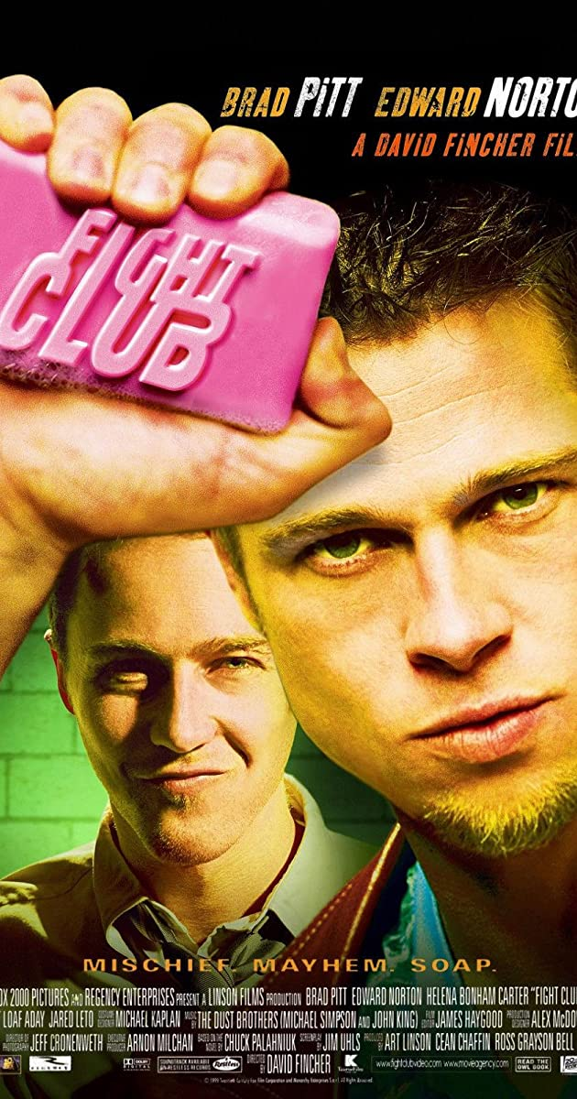
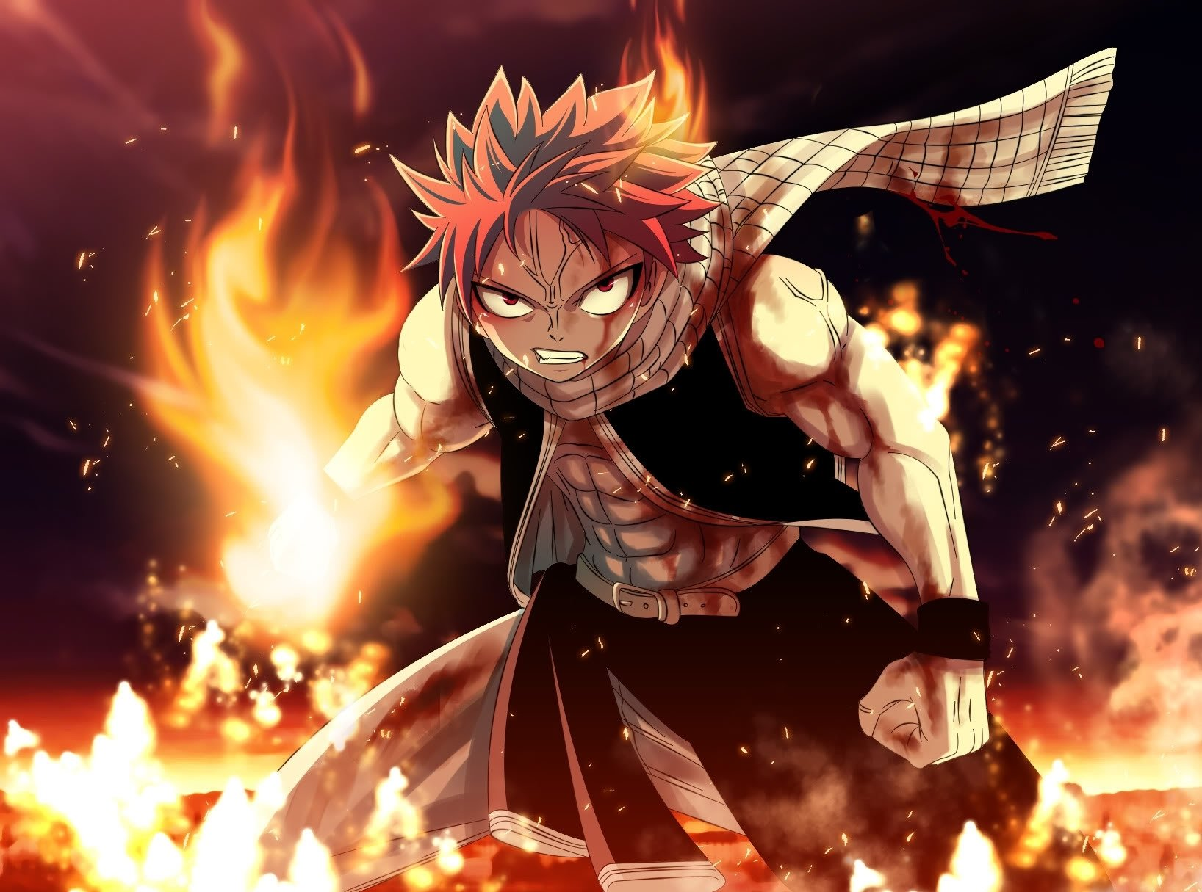

Slide 3
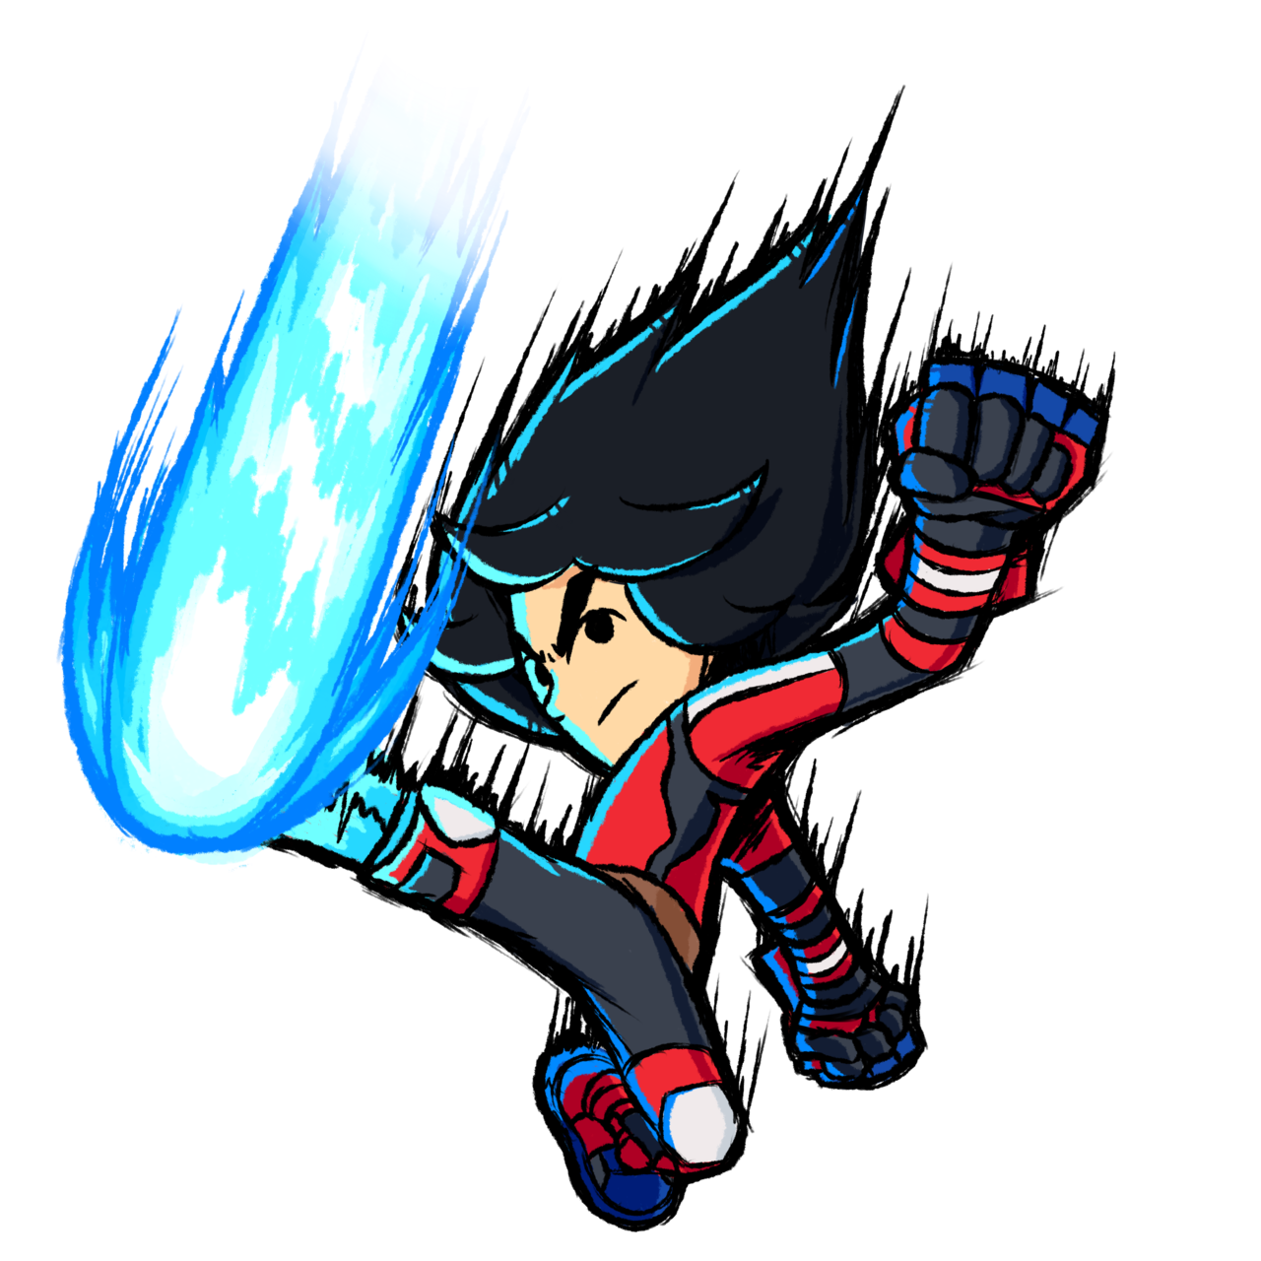
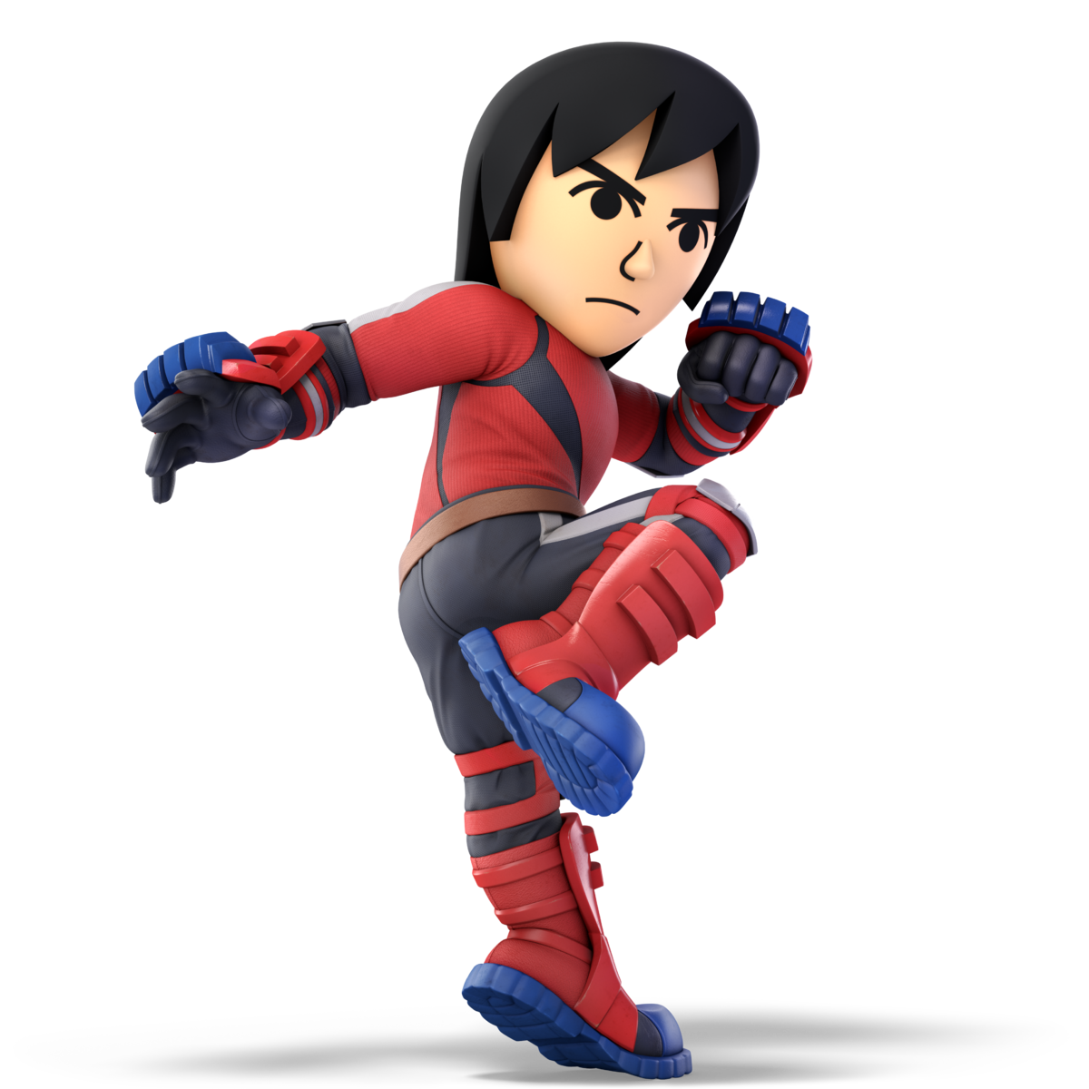
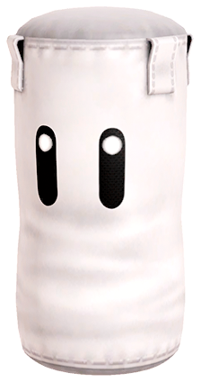
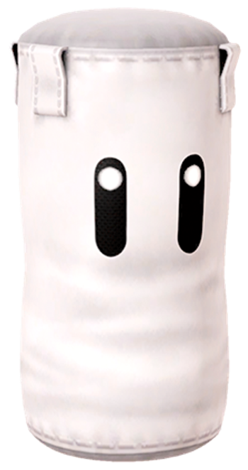

Slide 4
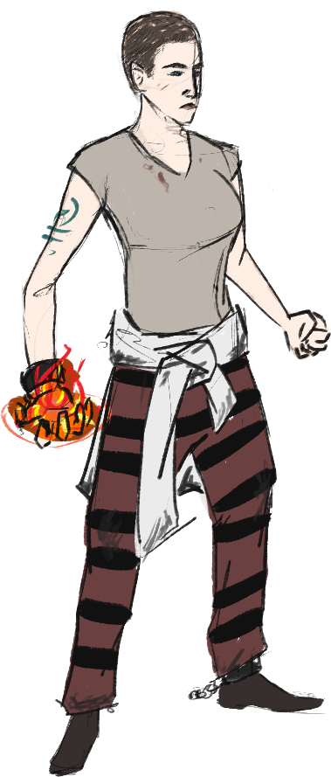
Prisoner P-432: Eva
Magically Gifted Street Performer
Arrested for use of un-regulated Magic
Strong willed and Rebellious

Slide 5
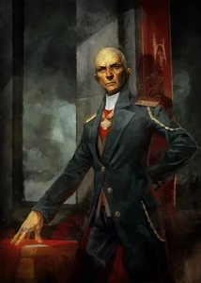
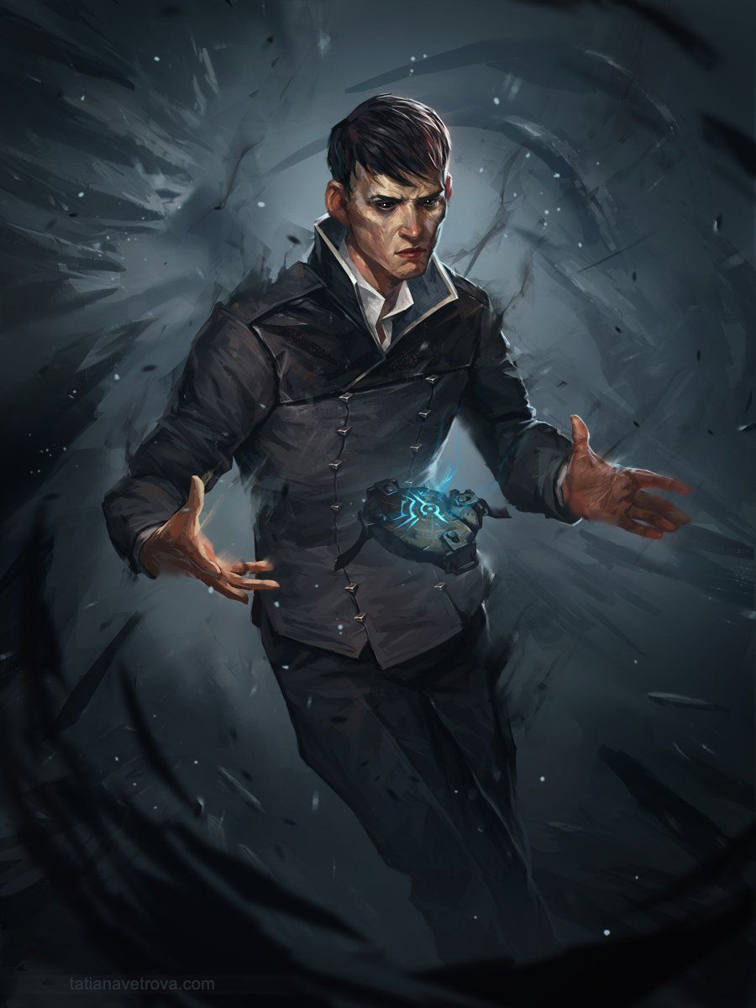
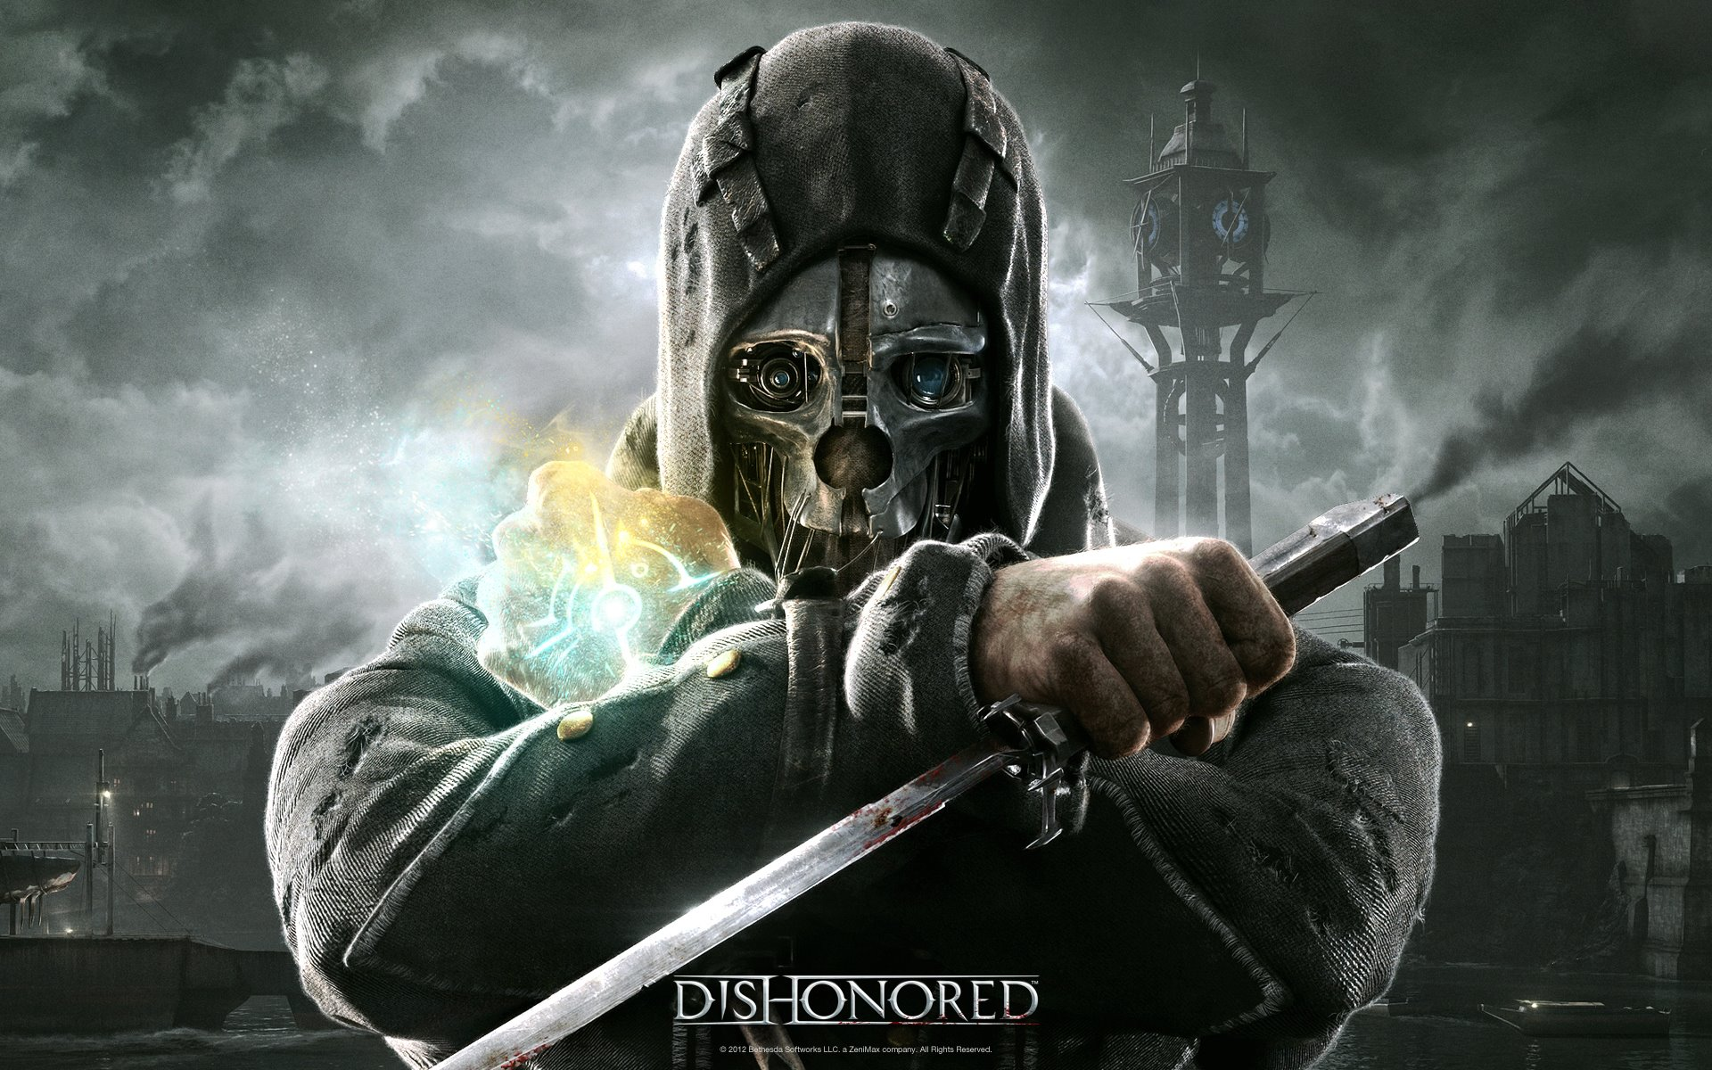
Art Possibilities
Notes:
Gaslamp fantasy
Edwardian tone and style
Ruffer militaristic styles
Merge it with design punk with magic
Elegant and rustic at the same time

Slide 6
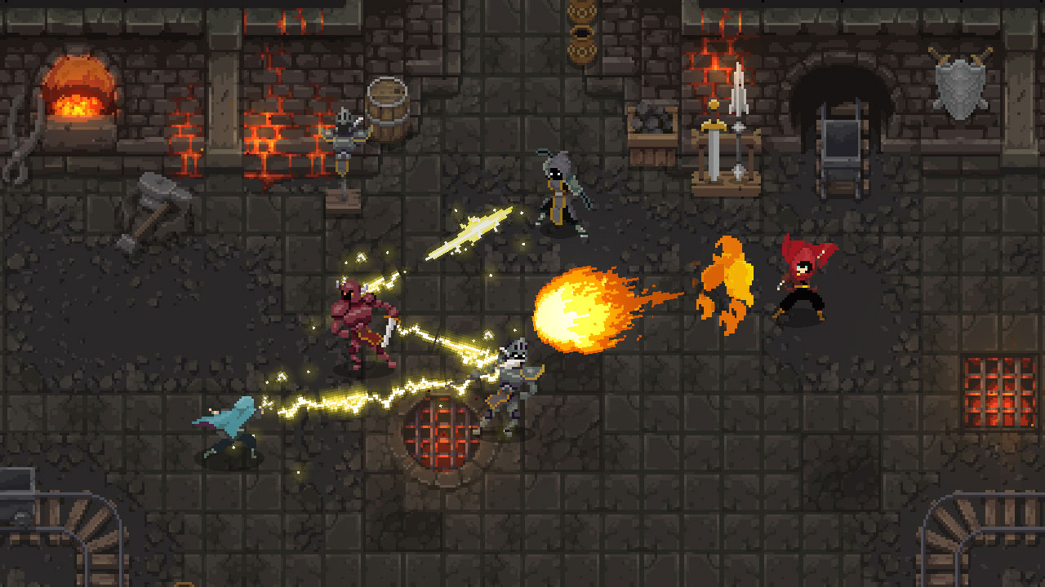
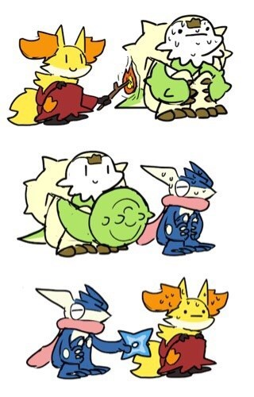
Design Possibilities
Various Spells to Collect
Spells have various effects
Spell advantages and disadvantages
Lore & Story
Notes:
Various spells to use and collect
Each with there own unique effect on the battle
Spells react with both enemies and other spells
Weapon triangle but magic
Lore section (TBD)

Slide 7
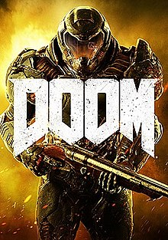
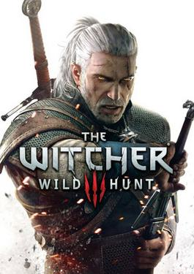
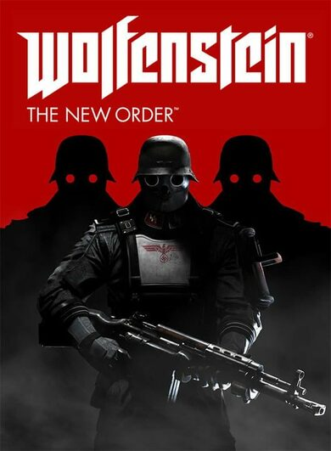
Target Market
Excitement
Story
Power

Slide 8
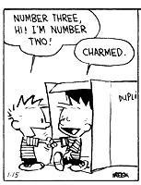
Code Possibilities
Reusable Assets
Cohesive and robust Combat
Lots of Variables
Notes:
Assets can be reused more frequently
Cohesive and robust combat system
Particle & sound effects
Numbers for Matt to balance
Learning how to implement controller.

Slide 9
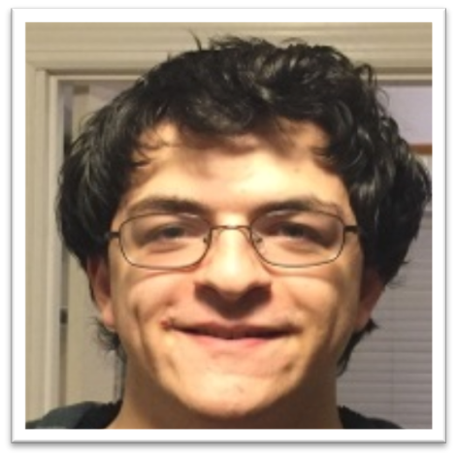
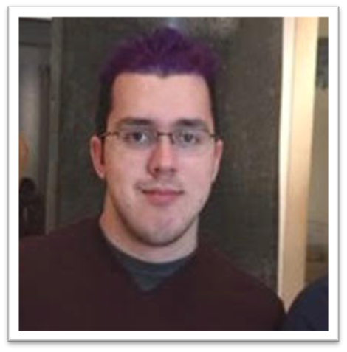
Why it fits the Team
Sound design is interesting
‘Spell system is what I excel at’
More complex FX
Lots of UI
Level design
Lots of balance
Game feel

Slide 10
Why it fits the Team
Character design
Exploring Gaslamp
Narrative Designer
Level designer
Game writing Minor
Written for games.

Slide 11
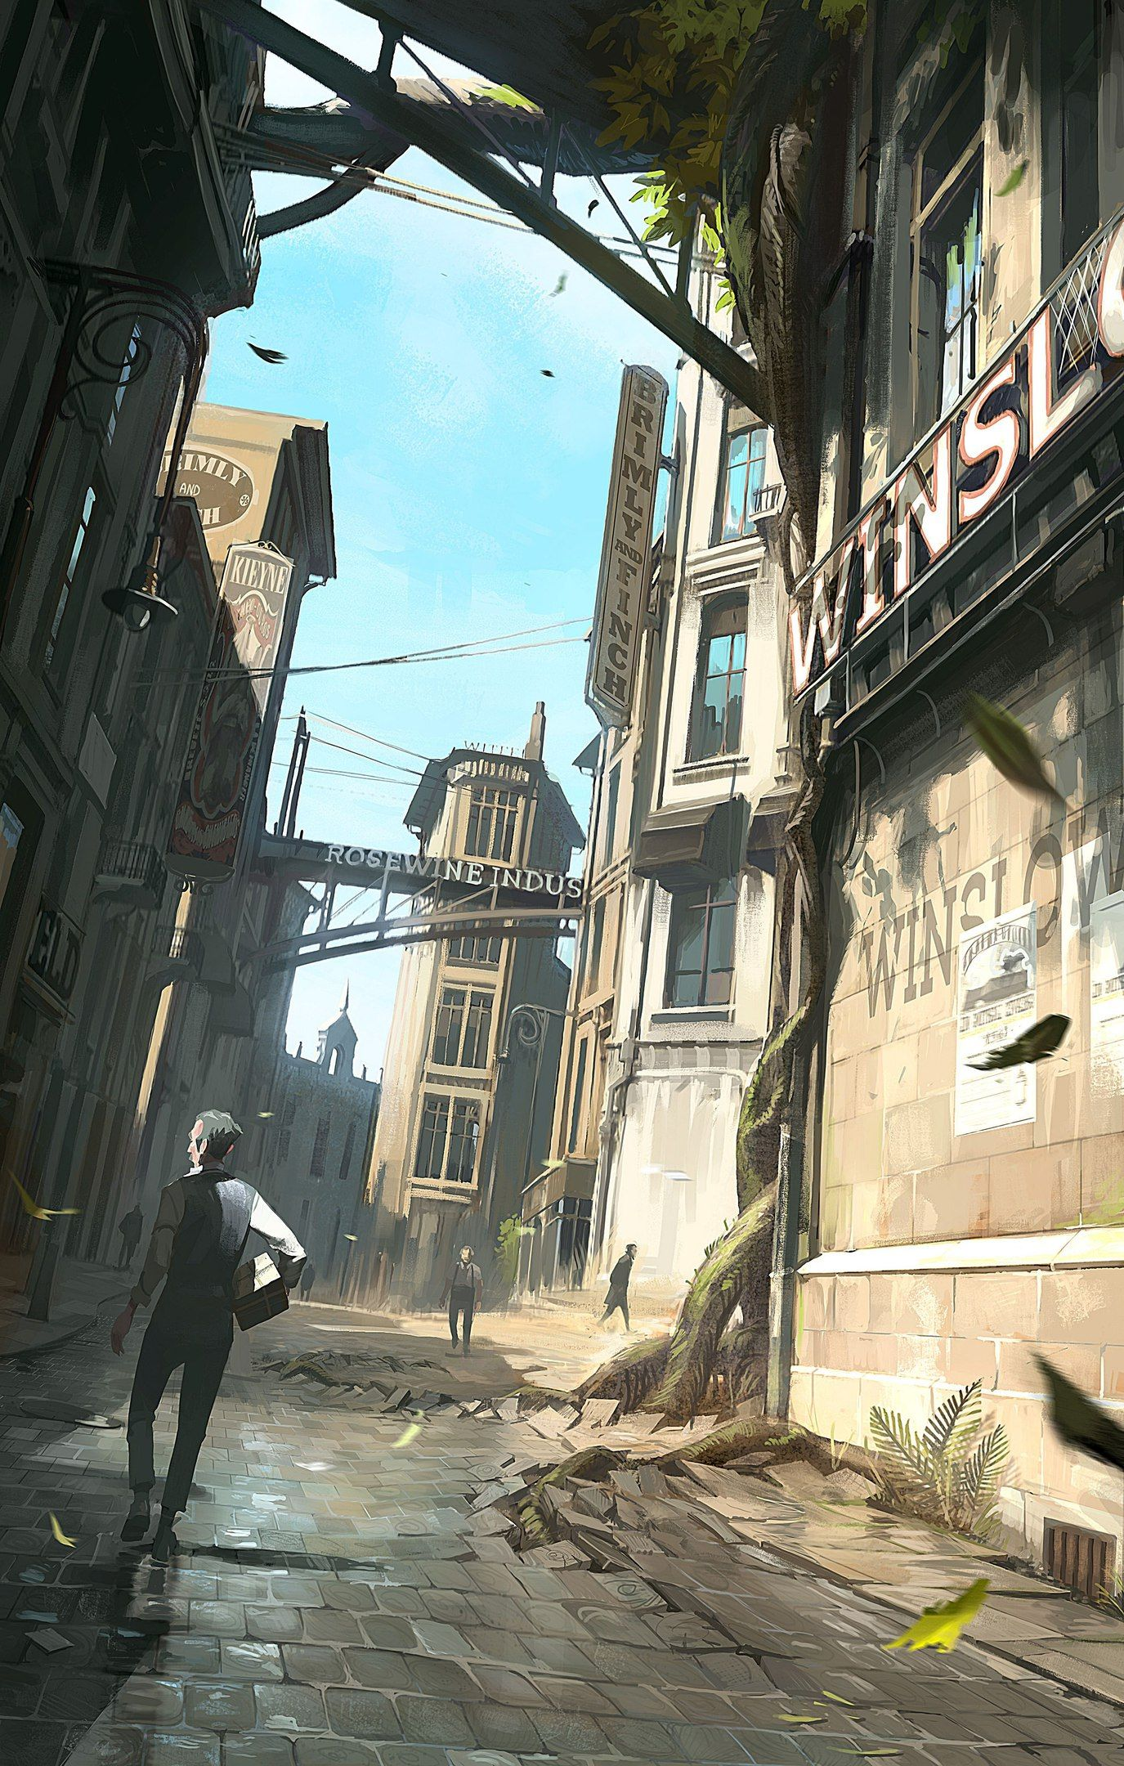
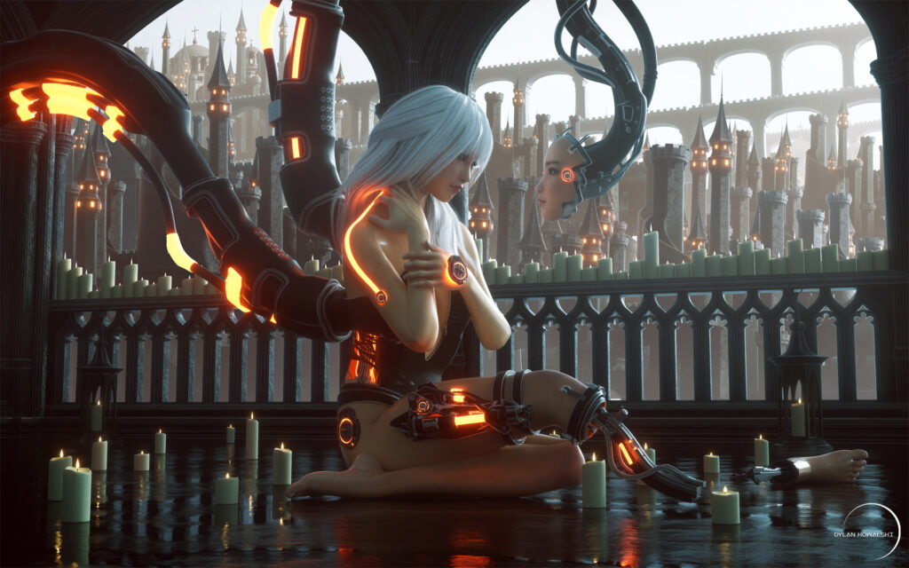
Risks: Art
No environment artist
Consistency to Art Genre

Slide 12
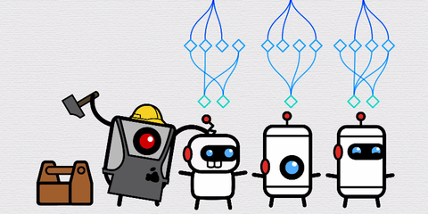
Risks: Programming
No dedicated AI programmer
Difficult on keyboard

Slide 13
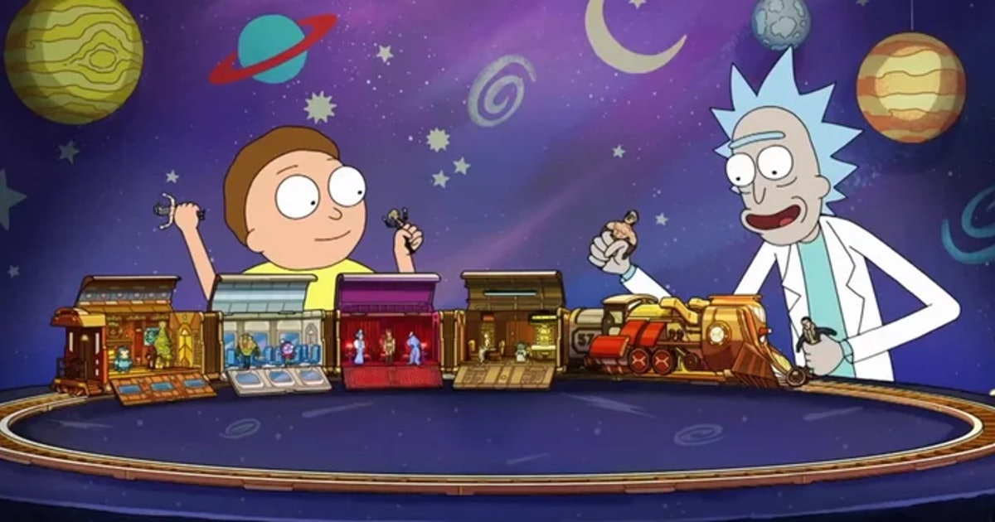
Risks: Design
Story could go off the rails

Slide 14
Questions? Concerns? Comments?

Slide 15
Thank You!

